Slide 1

Benchmarking PostgreSQL for Success
By Kellyn Gorman
Advocate and Engineer

Slide 2

About Me
Kellyn Gorman
Advocate and Engineer at Redgate
Data and AI Specialist
30 years in relational systems

Slide 3

Goal of this Exercise
Test out AlloyDB Omni on various clouds and storage.
Identify performance bottlenecks in configuration, operating system or hardware.
Test it against other flavors of PostgreSQL.
Options to optimize and report back limitations.
In the end, resulted in a life of it’s own…

Slide 4
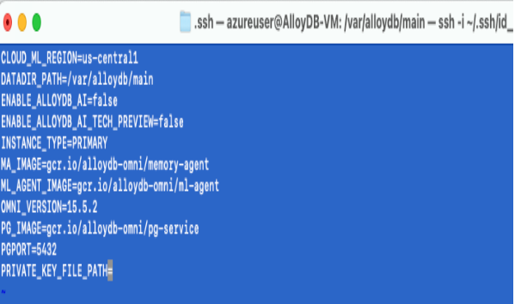
AlloyDB Omni
AlloyDB is Google Cloud’s PaaS version
AlloyDB Omni is new and in its infancy.
Unlike the PaaS version, it can be run in any cloud, on-premises, hybrid, etc.
Configurations outside of the pg.conf file or database, (dataplane.conf, etc.)
Virtualization on top of virtualization between Cloud VM, docker, Kubernetes and other layers.
https://cloud.google.com/alloydb/omni/docs/quickstart

Slide 5

CONFIGURATION
https://www.postgresql.org/docs/current/runtime-config.html

Slide 6

Environments
AlloyDB Omni from Google(15.4-15.7)
Deployed inside Docker container
I ran Omni in Azure and Google-
Azure 16vCPU E-series VM
Google 16vCPU N2 series VM
Scaled up from 16 vCPU
Azure/Google native and then Silk storage layer for high IO
26G database as part of HammerDB TPC-C and more for TPC-H
https://cloud.google.com/alloydb/omni/docs/configure-omni

Slide 7
HammerDB
Always use a separate machine for HammerDB. Don’t run on the database host!
1st Install: VM in same resource group
2nd Install: Docker Container and then installation.
Nope, installed it direct on the VM, docker makes no sense on a VM for HammerDB.

Slide 8
Install PostgreSQL Client to Connect
AlloyDB Omni or any flavor of PostgreSQL
Requires PostgreSQL client to connect HammerDB to connect.
Install and configure HammerDB

Slide 9

Further Introductions During Test
PostgreSQL 16.6, 17.2, Yugabyte
Previous Benchmark Results from various publications that were already certified.
Multiple machines for partitioned/distributed scaling.
https://www.postgresql.org/

Slide 10
BENCHMARK
https://www.hammerdb.com/

Slide 11
What is HAMMERDB
Open-source benchmarking tool
Simulates real-world workloads (OLTP & analytical)
Measures transaction speed and query throughput
Provides key metrics (TPM, NOPM)
Easy setup with GUI and CLI options
Multi-threaded for effective stress testing
Useful for capacity planning and bottleneck detection

Slide 12
HAMMERDB
Installed on separate VM
With PostgreSQL extension
Configured with access to PostgreSQL container/server
Used with BASH or TCL Scripts

Slide 13
Perf Runs
Change enhancement implemented
Clean cycle, warm up run, then performance run
Measure
Keep change or revert
New test change implemented
Rinse and repeat

Slide 14
RECOMMENDATIONS
https://www.postgresql.org/docs/current/runtime-config.html

Slide 15
When Optimizing for Performance
Always a combination of:
database configuration.
Database code/design
Infrastructure

Slide 16
Always Use Newest VMs
New VMs have:
New Features
Higher thresholds
Newest hardware specs
Rarely takes more than a couple minutes to perform an upgrade to the newest compute in the same series family.
When choosing VM, consider memory/compute optimized series with large series family.
https://learn.microsoft.com/en-us/azure/virtual-machines/
https://cloud.google.com/compute/docs/machine-resource

Slide 17
Speedy WAL Writes
Choose Tier 1 storage for solid performance to keep up with WAL writes.
Have a dedicated POSTGRES user that owns the database directories and installation.

Slide 18
Native Attached Storage vs. Network Attached
Native storage solutions and PaaS have stringent limits.
PaaS is often very limited combinations.
Native storage are limited at the VM, not the storage.
Always read the quota and limits in the documentation for the product and solution tier.
IaaS with network attached storage have fewer limitations.
Can achieve upwards of 20 – 32 GBPs IO.
May require more advanced configurations.
Always verify, especially with virtualized or containers that PostgreSQL is USING the storage.

Slide 19
Results
Native PV2 on Azure
Silk with 2 c-nodes, no optimization
Vuser 1:TEST RESULT : System achieved 465213 NOPM from 1031103 PostgreSQL TPM PostgreSQL TPM
Vuser 1:TEST RESULT : System achieved 18091 NOPM from 41662 PostgreSQL TPM

Slide 20
PostgreSQL Optimization

Slide 21

Configuration Files - *.conf
Specific Parameters
Setting Parameters
Dynamic vs. Static Parameters

Slide 22
Cache More
effective_cache_size
Although a guideline and not a guarantee, it’s important to let the database server know how much cache is available to the kernel
If IO is being tested, this should be done in moderation.
Effective_cache_size=RAM*.07
Or 70% of the total RAM is standard!
Notes:
Default is 4GB
Size of filesystem cache,, CPU caches, etc.

Slide 23
Working Memory
work_mem
If you don’t have enough working memory, sorting will be impacted. Also ensure you calculate the most optimal value for this using the following calculation:
work_mem * total sort operations for all users = VALUE
Maintenance_work_mem
Maintenance tasks can be impactful to nighttime batch loads and other heavy, off-hours work.
Needed for RESTORE, CREATE INDEX, ADD FOREIGN KEY, ALTER TABLE, but most is used for any VACUUM command.
Notes:
4MB is default and too low.
Set it to 64MB for my PostgreSQL AlloyDB Omni environment.
This is enough for my sorting, etc. and not have to spill to the temporary file.

Slide 24
Misc Optimization Parameters
Synchronous_commit
Must be assessed for the optimal value between performance and reliability requirements. Consider going async for performance and if reliability is essential, then sync should be turned on to ensure commits won’t be returned until the WAL is written to disk.
Checkpoint_timeout/checkpoint_completion_target
Notes:
Set to OFF, a few commits may be lost.
Set to LOCAL, local WAL Write first and then WAL flush completes
Rremote_write- must be handed over to remote instances and acknowledged before they can be flushed.
ON is the default value (on, true, yes, 1)requires an acknowledgement from the remote standby if there is one before it will release.
Remote_apply is the longest wait on commit, as it must receie a synch commit from all standbys before it flushes.
Local is the least risky with fastest response times.

Slide 25
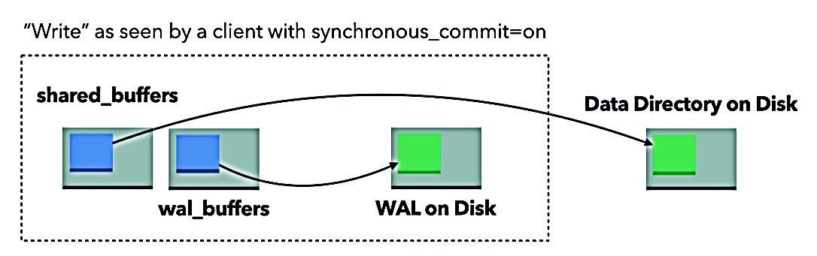
Visualizing Writes

Slide 26
Configure Optimal CPU
Install the Linux Tools to support, (/usr/lib/linux-tools)
Set the cpufreq governor to performance:
./cpupower frequency-set –governor=performance

Slide 27
Verify CPU Performance Configuration
./cpupower frequency-info
analyzing CPU 0:
… The governor “performance” may decide which
Boost state support:
Supported: yes
Active: yes

Slide 28
Check Idle state for CPUs
./cpupower idle-set –enable-all
./cpupower idle-info
CPUidle driver: intel_idle
CPUidle governor: menu…
Notes:
check that the idle settings are enabled
(for Intel CPUs) that the intel_idle driver is used.
Note that the pstate and cstate drivers work together to provide the most efficient use of turbo boost.
Initially it is best leave all of these states enabled.
Disabling all C-states or Idle states is likely to reduce overall performance by reducing the available turbo frequency
. You can experiment with the C-states between ‘all or nothing’ to find the optimal settings.

Slide 29
How Boost States Are Used
Value of 0 is the performance setting:
Set to performance:
./x86_energy_perf_policy performance
Verify by calling the policy for performance and ensuring the CPUs are each listed:
./x86_energy_perf_policy –rcpu0: EPB 0
Notes:
Verify if the VM or machine you’re on supports boost.

Slide 30
Configure Huge Pages
Calculate the Huge Pages allowed, then update the /etc/sysctl.conf file:
net.core.rmem_max = 4194304
net.core.wmem_default = 262144
net.core.wmem_max = 1048576
fs.aio-max-nr = 1048576
vm.nr_hugepages = 35000

Slide 31
Add the Change to the Limits Configuration
Add to the /etc/security/limits.conf file:
As ROOT, issue the following to implement the change:
sysctl -p
postgres soft memlock 100000000
postgres hard memlock 100000000

Slide 32
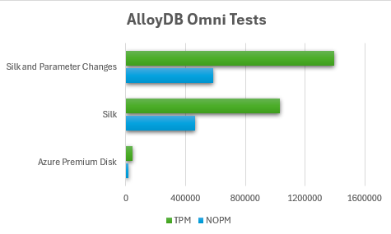
Results
16 vCPU optimized
Vuser 1:TEST RESULT : System achieved 585562 NOPM from 1393581 PostgreSQL TPM
35% Improvement in Performance!

Slide 33
Monitoring: PostgreSQL Views
https://www.postgresql.org/docs/current/monitoring-stats.html

Slide 34
Database Information
Views in PostgreSQL includes wait events.
Enhancements regularly with releases.
Some data is cached.
May need to use other products in conjunction with views.
https://dataegret.com/2017/03/deep-dive-into-postgres-stats-pg_stat_database/

Slide 35
PG_STAT_ACTIVITY
Does not expose back-end memory use.
Use OS level options to gain complete picture.
Marry with check_postgres or Redgate Monitor, etc.

Slide 36
PG_STAT_WAL
Displays WAL activity
SELECT * FROM PG_STAT_WAL\gx
-[ RECORD 1 ]----+------------------------------
wal_records | 1423
wal_fpi | 124
wal_bytes | 849300
wal_buffers_full | 0
wal_write | 16
wal_sync | 0
wal_write_time | 0
wal_sync_time | 0
stats_reset | 2024-04-12 11:16:31.921345+01

Slide 37
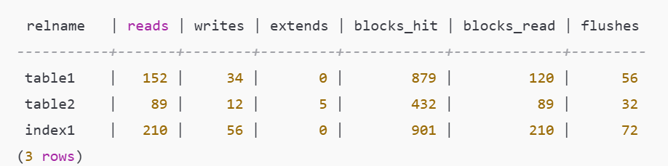
PG_STAT_IO
Depending on version, can offer a good look at IO in PostgreSQL for objects:
SELECT * from pg_stat_io
WHERE READS <> 0
OR EXTENDS <> 0;

Slide 38
Monitor Shared Buffer Evictions
Shared buffers are [Commonly] 8k in size
Shared_buffers =128MB, (i.e. 16K pages)
If filled, then eviction occurs
Can use pg_buffercache extension to monitor

Slide 39
Querying Maintenance in PG_STAT_IO
SELECT * FROM pg_stat_io
WHERE backend_type = 'autovacuum worker’
OR (io_context = 'vacuum' AND (reads <> 0
OR writes <> 0 OR extends <> 0));
backend_type | io_object | io_context | reads | writes | extends | op_bytes | evictions | reuses | fsyncs | stats_reset
--------------------+-----------+------------+---------+---------+---------+----------+-------
autovacuum worker | relation | bulkread | 0 | 0 | | 8192 | 0 | 0 | | 2024-04-13 11:50:27.492456-07
autovacuum worker | relation | normal | 14396 | 2354 | 1285 | 8192 | 17785 | | 0 | 2024-04-13 11:50:27.492456-07
autovacuum worker | relation | vacuum | 5824251 | 3425674 | 0 | 8192 | 2734 | 5234570 | | 2024-04-13 11:50:27.492456-07
client backend | relation | vacuum | 138746 | 0 | 0 | 8192 | 1265 | 139849 | | 2024-04-13 11:50:27.492456-07

Slide 40
PG_STAT_DATABASE
Cache Hit Ratio
Commit Ratio
Database Outliers
Load Distribution

Slide 41
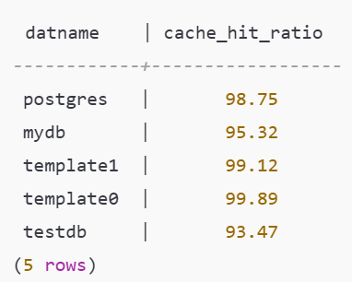
Using PG_STAT_DATABASE
SELECT datname, 100 * blks_hit / (blks_hit + blks_read) as cache_hit_ratio FROM pg_stat_database WHERE (blks_hit + blks_read) > 0;
Notes:
datname: The name of the database.
cache_hit_ratio: The percentage of data blocks served from memory (cache hits) versus those read from disk. A higher ratio indicates better performance.

Slide 42
MISC VIEWS
PG_STAT_ALL_TABLES
PG_STAT_ALL_INDEXES
PG_STATIO_ALL_TABLES

Slide 43

Caveats with the Misc Views
Displays IO information on all tables
If there was a manual reset (pg_stat_reset() performed) data may be inaccurate.

Slide 44
VACUUM
https://www.postgresql.org/docs/current/sql-vacuum.html

Slide 45
When to VACUUM
Disable both checkpoint and vacuum job as part of test or you may experience long waits. Auto vacuum during test is less impactful.
Hammerdb>diset tpcc pg_vacuum false
Changed tpcc: pg_vacuum from tru to false for PostgreSQL

Slide 46
Tracking with Vacuum
You can track cumulative IO via autovacuum and manual vacuums.
Autovaccum or manually vacuum the right amount.
Avoid doing manual vacuum during benchmark tests
Complete view of waits can be found in PG_STAT_IO

Slide 47
SCALING
https://www.hammerdb.com/

Slide 48
Scaling Issue
Couldn’t get to scale past 16vCPU for any flavor without clustering.
Network attached storage was limited in scaling, unless scaled with multiple nodes.
https://www.crunchydata.com/blog/an-overview-of-distributed-postgresql-architectures

Slide 49
Single Instance Results with 16 vCPU

Slide 50
Lacking Scaling
Performance Stagnated!

Slide 51
Single Node Throughput
FIO
Barely 5% utilized on Silk Data Pod

Slide 52
Multi-Node Solutions
FIO

Slide 53
Cloud Cost Breakdown
https://dbakevlar.com/2024/07/hammerdb-and-postgresql-part-i/

Slide 54
Cost Per NoPM

Slide 55

In Summary
HammerDB offers clears information on TPM performance but may require secondary tools/logs to identify performance and opportunities for improvement.
PostgreSQL shows limited scaling without clustering above 16 CPU in the tests performed.
Recommendations here can be used for any flavor of PostgreSQL and different flavors have their uses.

Slide 56
QA
Kellyn Gorman
Advocate and Engineer, Redgate

Slide 57

Thank You!
Kellyn Gorman
Engineer and Advocate, Redgate
Kellyn.Gorman@red-gate.com
https://LinkedIn.com/in/kellyngorman
REFERENCES
AlloyDB Omni Benchmarking Guide
What I Learning Benchmarking Citus and Postgres with HammerDB
Postgres Price vs. Performance Benchmarking
HammerDB and PostgreSQL

